Slide 1

Power BI Analysis of IPL Matches & Player Stats – 2009-2018

Slide 2
In order to make visualizations or dashboards in Power BI firstly we have to download the dataset in our local system so that we can load the data into Power BI . We have different types of websites such as Kaggle or Mockaroo etc where we can download different types of datasets.
For this project I am using IPL 2009-2018 Dataset.
In order to make dashboards in Power BI,
Importing Data
Data Modeling
Creating Visualizations
Formatting

Slide 3
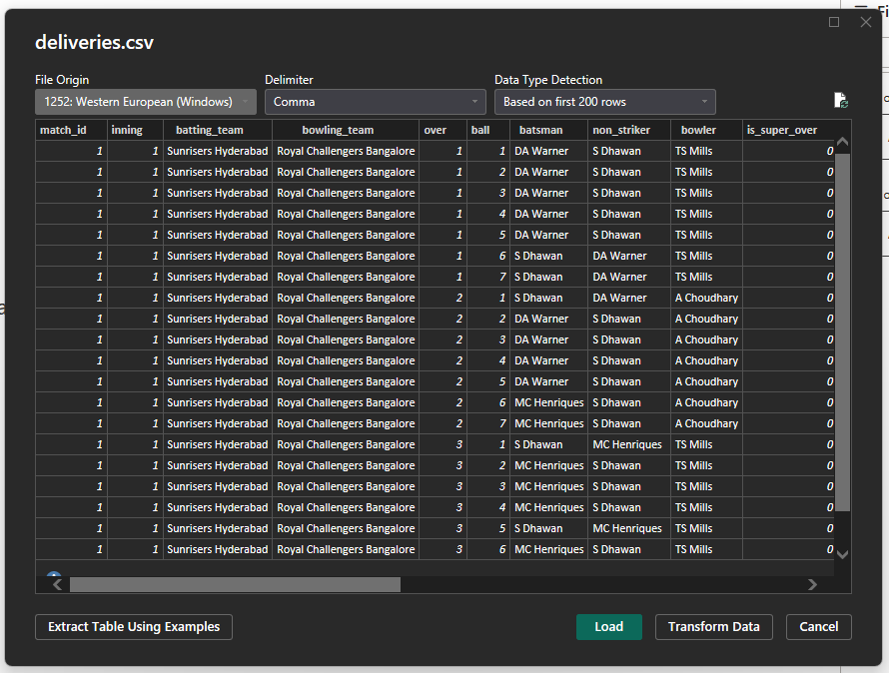
DATA LOADING OR IMPORTING DATA
In order to load the data click on “Get Data” in the ribbon bar and select the “Text/CSV” option and select the dataset and click on Load option to load the data.

Slide 4
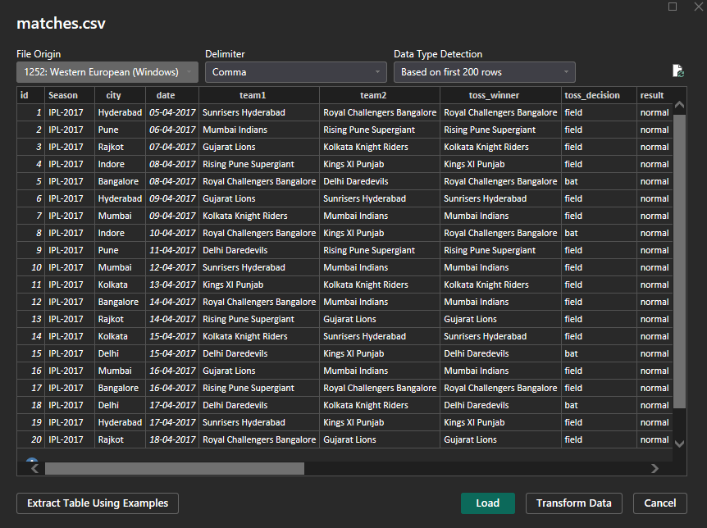
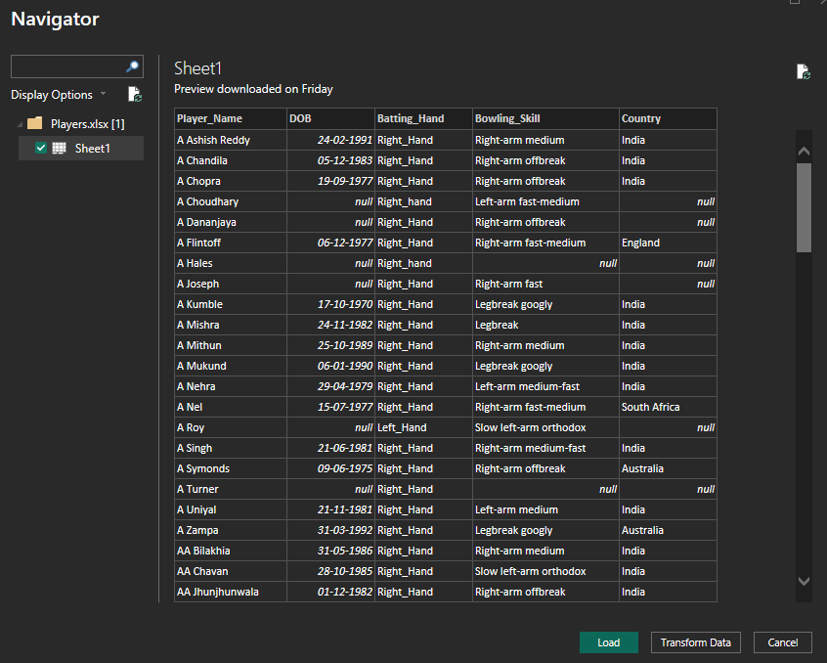
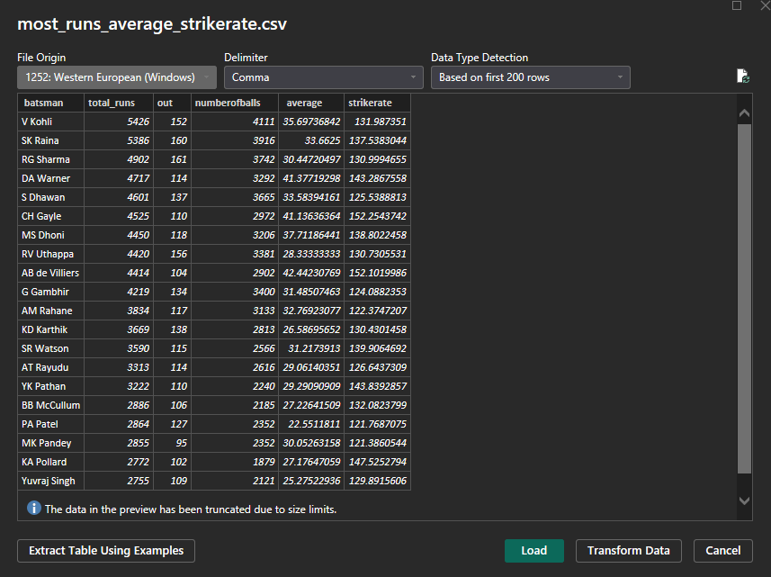
PREVIEWS

Slide 5
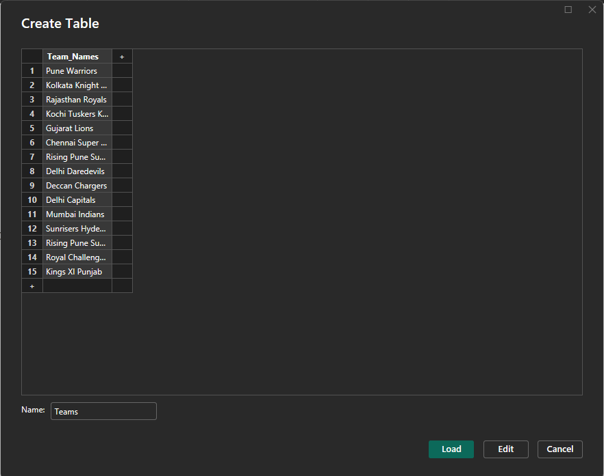

MANUAL DATA
We can even enter the data manually by clicking on Enter Data available on home bar and we can just paste or type our data.
Enter the table name in the left bottom box beside Name.

Slide 6
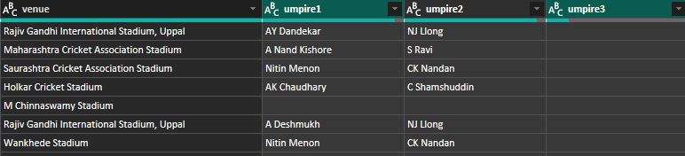
DATA CLEANING
Data cleaning, also known as data cleansing or scrubbing, is the process of identifying and correcting errors, inconsistencies, and inaccuracies within a dataset to improve its quality.
In order to perform Data Cleaning in Power BI we have to click on Transform Data option available in ribbon bar.
REMOVE COLUMNS
Rename Columns option is very much helpful because there can be some columns which does not have any use while analyzing it. By removing these columns it saves storage. To remove columns select the columns and click on Remove Selected Columns option in Manage Columns bar.
The name of the umpire is not any use while analyzing the data or match id is also not at all useful so we can remove these columns as it helps to enhance speed of the model.

Slide 7
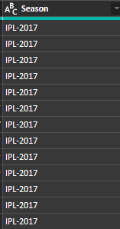
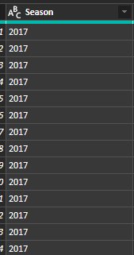
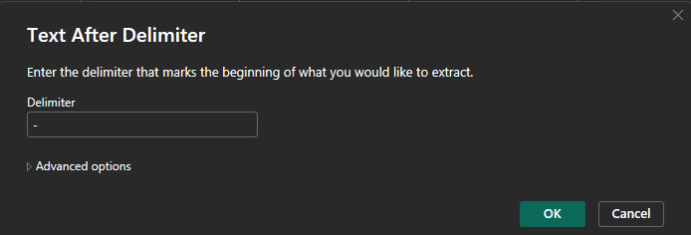
EXTRACT
In some cases the values of a column consists of both useful and useless things.
In my dataset in season column it repeated itself as IPL-year but it doesn’t make sense as it is an IPL dataset so in this case we can use Extract option and in Extract we have different options that are available. Since I want to keep the text after “-” so I have selected Text After Delimiter option.

Slide 8
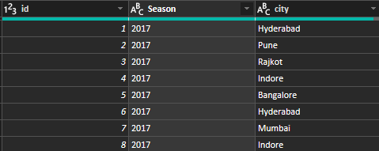
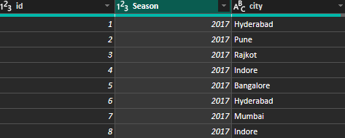
CHANGING DATA TYPE
We can change the data type of any column by going to Transform option and then changing it’s data type to our desired one.
We have changed the data type of Season column from Text to Whole Number.

Slide 9
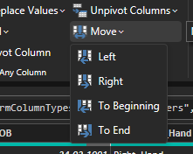
MOVE
There is an option called Move where we can move the columns to the right or left or beginning or end.
FORMULA BAR
The formula bar in Power BI is a key tool for creating and managing formulas, particularly within the Power Query Editor and when defining measures or calculated columns. It allows you to write and edit DAX or M language formulas, which are used to transform, analyze, and visualize data. The formula bar displays the M language formula for the currently selected step in the "Applied Steps" pane.

Slide 10
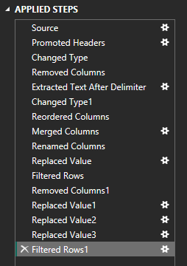
APPLIED STEPS
It shows all the steps that we have performed since from the start in that table.
For some of the steps in the above picture there is a settings icon beside that step. If we click on that icon it will give a pop screen that shows what we have done on that step and we can even change if necessary.

Slide 11
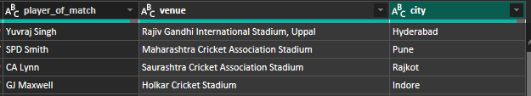
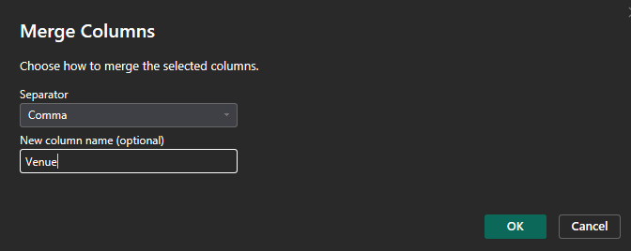
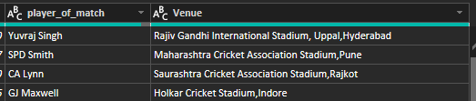
MERGE COLUMNS
We can even combine multiple columns into a single column.
For example in matches tables there are two columns called as city and venue where the city column represents the place of venue so we can use merge column option to combine both the columns into a single column by selecting both the columns and clicking on Merge Columns option.

Slide 12
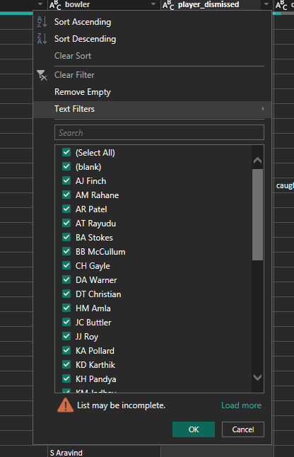
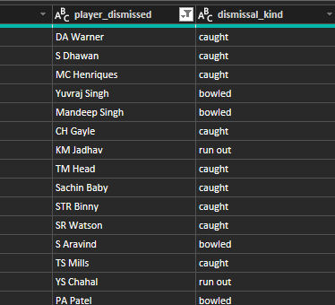
FILTER
Filter option is used when we want to select rows based on a particular column value.
In the deliveries table there is a row for every single ball bowled in the entire time period the dataset has taken but it is not necessary we can just keep the rows only when a wicket has been taken place.
In order to use Filter option just select the dropdown arrow beside the column name.
If we unselect the (blank) then all the column that are empty will be filtered out.

Slide 13
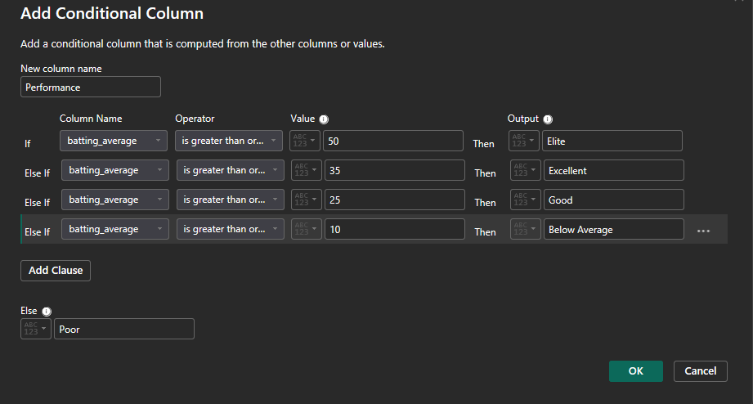
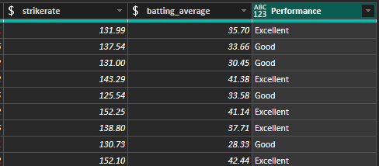
CONDITIONAL COLUMN
We can add conditional columns which is available in the Add Column option. It will add a column value based on the condition it satisfies.

Slide 14
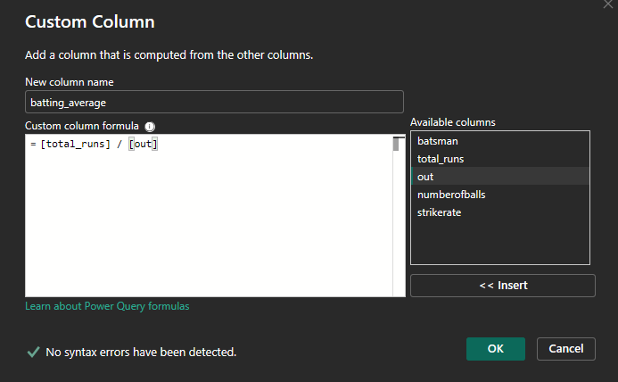
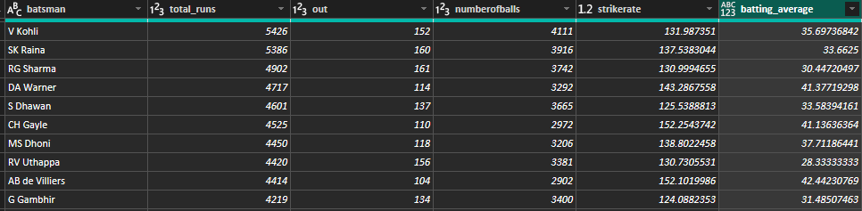
CUSTOM COLUMN
A Custom Column in Power BI using Power Query is a new column you create by defining a formula using the Power Query M language. This column is added to your data table and can have calculated values based on existing columns, constants, or other expressions. We can add a custom column in the Add Column option.
Calculated columns are created using DAX formulas and Custom columns, on the other hand, are created using the Power Query M language.

Slide 15
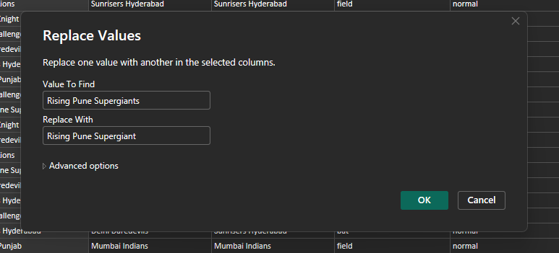
REPLACING VALUES
We can replace any value with any other value.
For example in the dataset in some rows the value is Rising Pune Supergiant but in some rows it is Rising Pune Supergiants because of this small change it affects the result of our model so we can use replace values to change the value.
To replace values we can either find it in home bar or we can right-click on the column name and select the replace option to replace values.

Slide 16
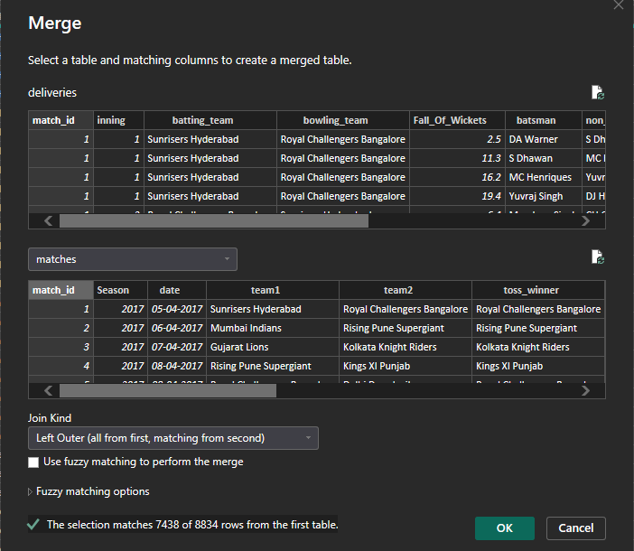

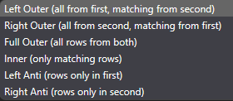
MERGE QUERIES
In Power BI, merging queries in the Power Query Editor allows you to combine data from two or more tables based on a common column, effectively joining them. In deliveries and matches table I have match_id as a common column. So we can merge these two columns by going to the combine section in the home bar.
There are 6 different types of joins :

Slide 17
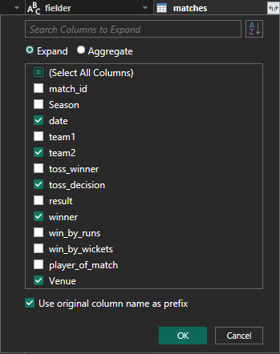
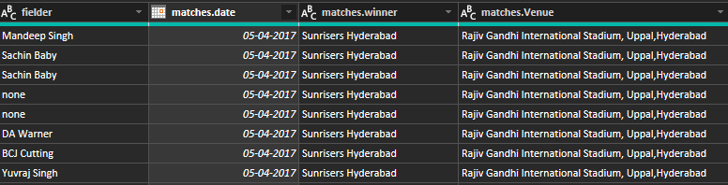
In order to add the columns to the table expand the matches column so that we can select the columns that we want to add and unselect those which we do not require, the selected columns will be added to the table. Then click on OK now the selected columns will be added.

Slide 18

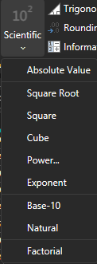
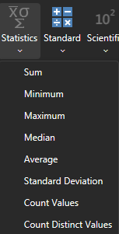
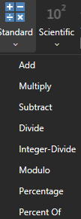
STATISTICS
We can perform different mathematical, standard and statistical operations in Power BI. We can use these operations only on number columns.
STATISTICS
OPERATIONS
STANDARD
OPERATIONS
SCIENTIFIC
OPERATIONS

Slide 19
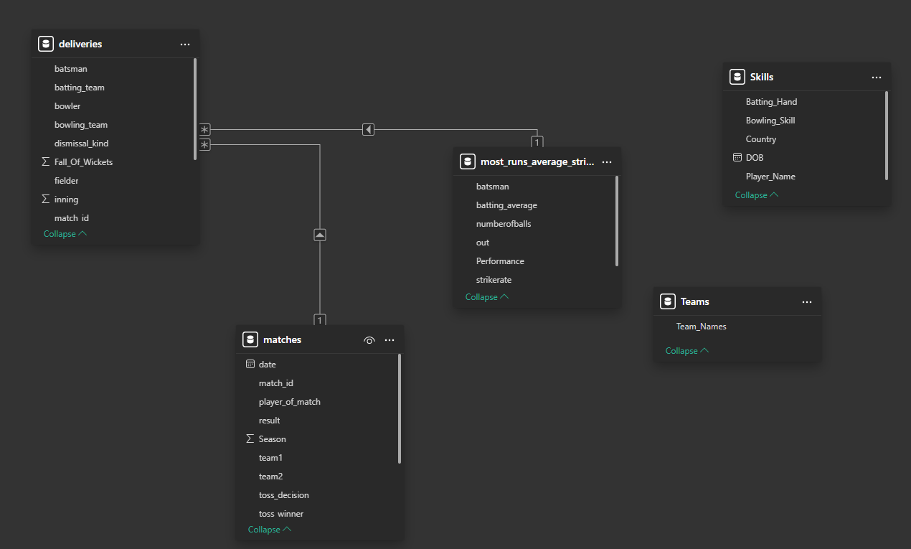
DATA MODELLING
Data modeling means creating a visual representation, or blueprint, of how data is organized, stored, and used within an information system. It helps define the structure, attributes, and relationships between data elements, providing a way to understand, manage, and query data effectively. Power BI automatically creates some relationships between tables.

Slide 20
RELATIONSHIPS
In Power BI, relationships define the connections between different tables in your data model, allowing you to combine and analyze data from multiple sources as if they were a single source.
There are three primary types of relationships: one-to-one, one-to-many, and many-to-many, each impacting how data is processed and displayed in reports.
1. One-to-One Relationships (1:1):
Each row in one table is related to exactly one row in another table.
2. One-to-Many Relationships (1:M):
A single row in one table can be related to multiple rows in another table.
For example, a customer can have multiple orders, but each order belongs to only one customer.
This is the most common type of relationship in Power BI.
3. Many-to-Many Relationships (M:N):
Rows in one table can be related to multiple rows in another table, and vice versa.
For example, a customer can purchase many products, and a product can be purchased by many customers.
Cardinality:
Refers to the nature of the relationship based on the number of related rows in each table.

Slide 21
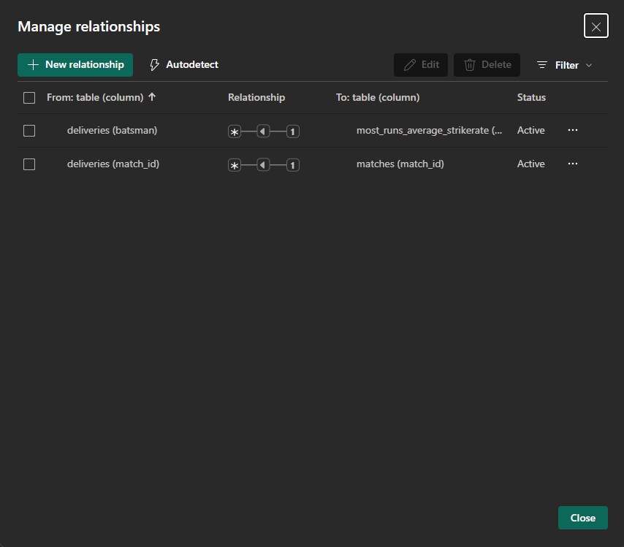

MANAGE RELATIONSHIPS
You can create relationships manually by using "Manage Relationships" or by dragging a column from one table to another. You can also have Power BI auto detect relationships, and then manage them, according to data.
We can find Manage Relationships option in the home bar.

Slide 22
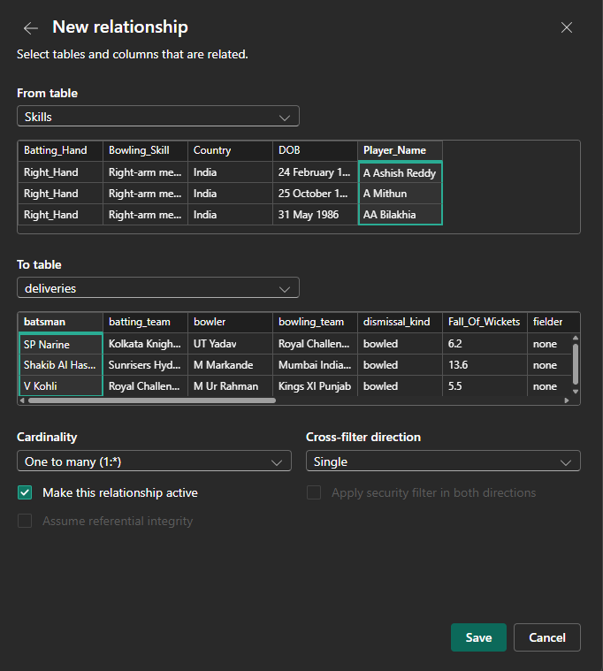
ADDING RELATIONSHIPS
In order to add new relationship we can click on New Relationship that is present in Manage Relationship Column. In order to create a relationship between two columns there must be a similar column in both the tables. In the Skills table I have a Player_Name column and in deliveries table I have Batsman column which are similar so I can add a relationship between these tables using this column so that we can analyze ball by ball data with player metadata.
Select the table and the similar columns and click on Save to add a relationship.

Slide 23
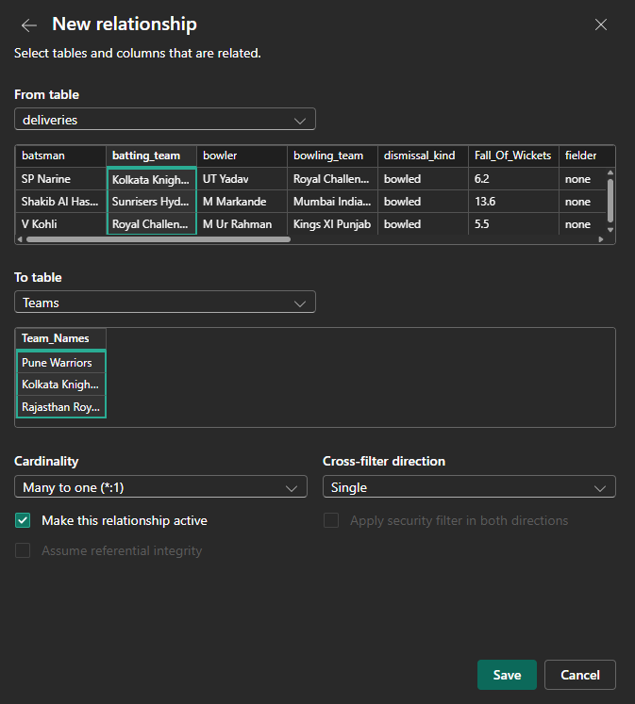
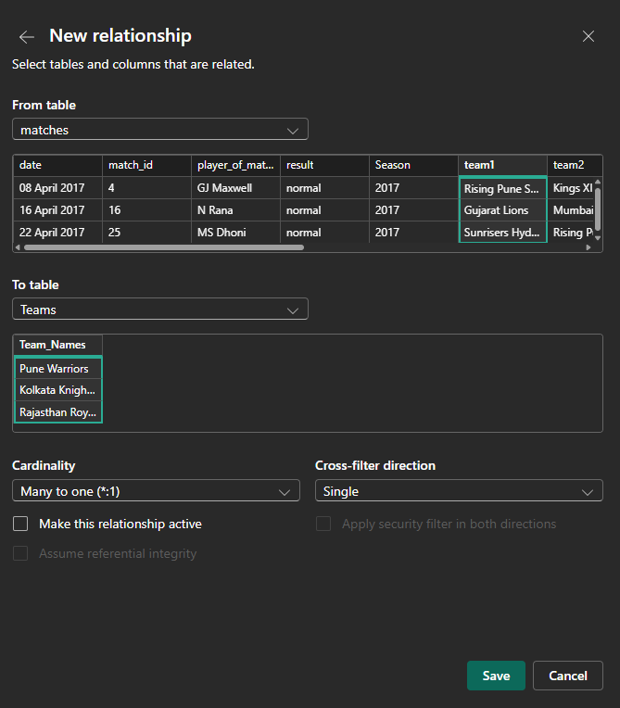
We can create a new relationship not only in the above method but we can just drag the similar column of one table to the similar column of another table.
I have created some more relationships between the tables.

Slide 24
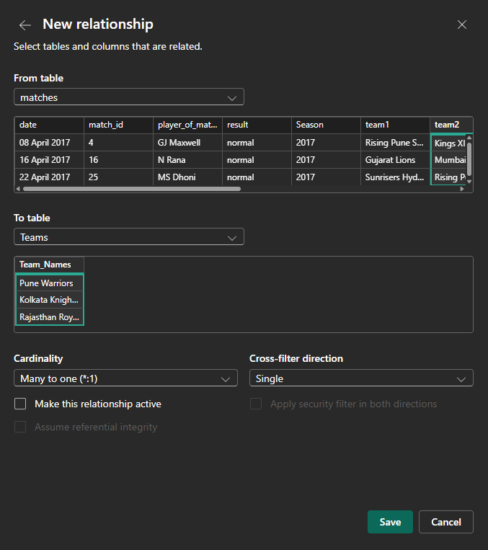
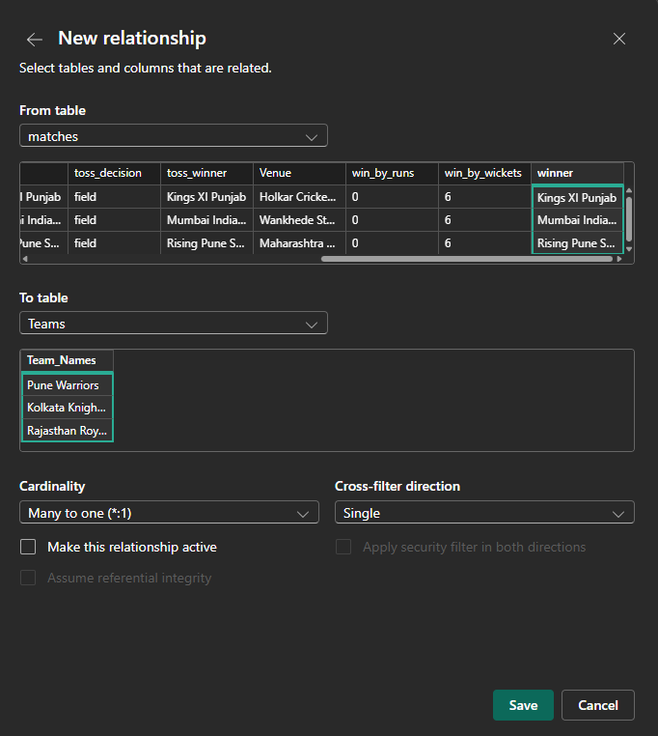

Slide 25
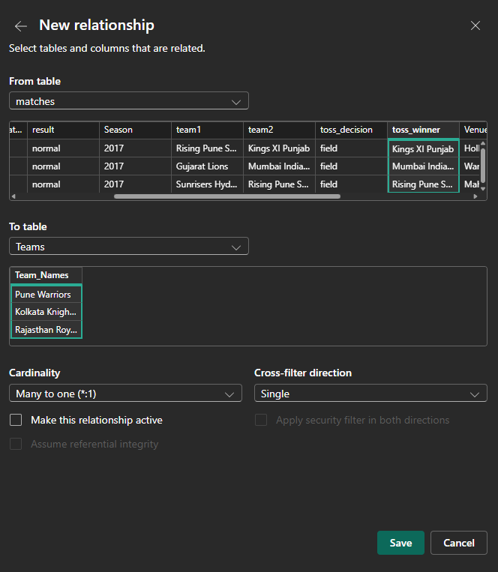
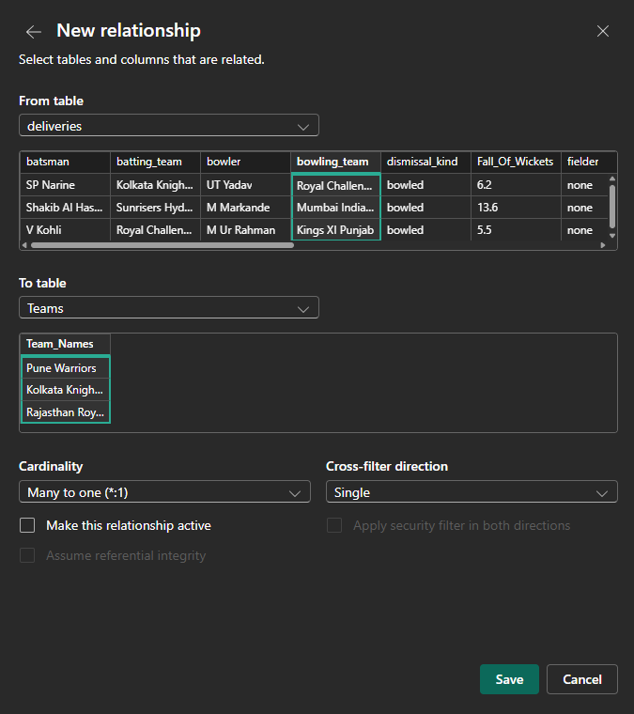

Slide 26
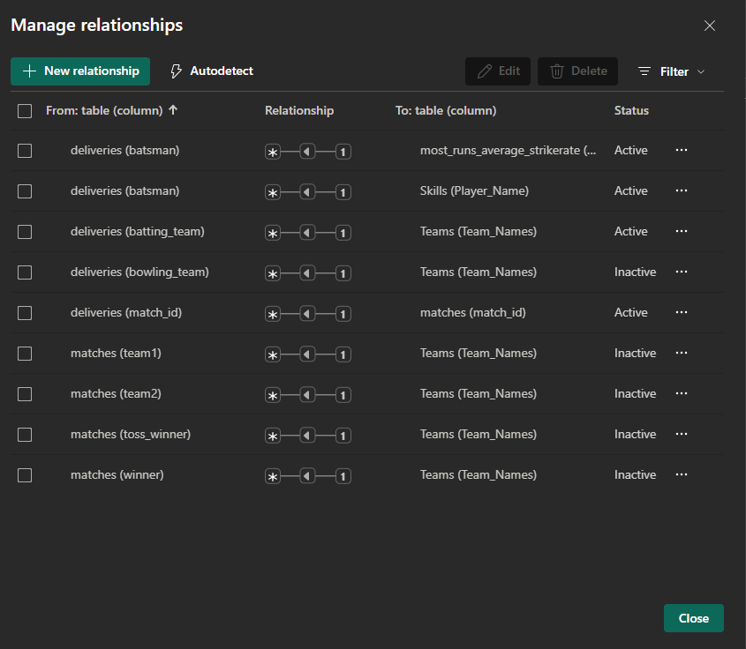
Since Power Bi allows to make only one relationship to be active at a time even if it is direct or indirect, we have to create some relationships and make them as inactive, we can change them into active by using DAX queries or changing in the Manage Relationships option by clicking on three dots beside the relationship.

Slide 27
DATA VISULIZATION
Power BI's data visualization capabilities allow users to turn raw data into visually compelling and interactive reports and dashboards, enabling better data analysis and decision-making. This process involves transforming data into various visual formats like charts, graphs, and maps to reveal insights and patterns. It is very easy to create visuals in Power BI, we can just drag the columns into the canvas area or select the columns and then selecting the visual.
Basic & Common Visualizations
Bar Chart
Clustered Bar Chart
Stacked Bar Chart
100% Stacked Bar Chart
Column Chart
Clustered Column Chart
Stacked Column Chart
100% Stacked Column Chart
Line Chart
Basic Line Chart
Stacked Area Chart
Ribbon Chart
Pie Chart
Pie Chart
Donut Chart
Combo Chart
Line and Stacked Column Chart
Line and Clustered Column Chart
Table
Matrix (Pivot table)
Card Visuals
Card (Single number)
Multi-row Card
Slicer etc

Slide 28
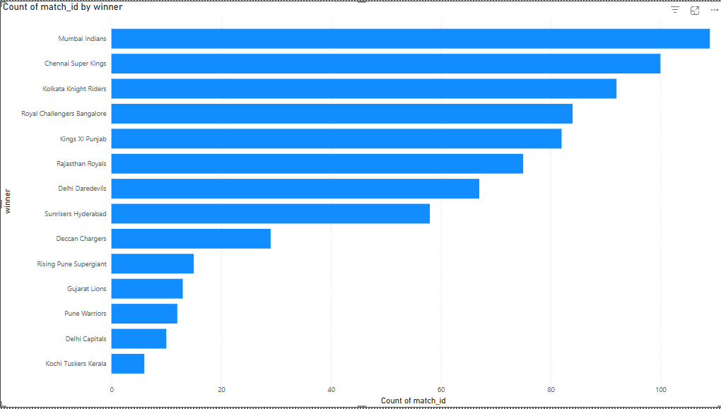
STACKED BAR CHART
By this visual we can understand how many teams have won how many matches. The team Mumbai Indians has won the highest number of times compared to other teams. If we drag the mouse near the bars, we can know the exact value.

Slide 29
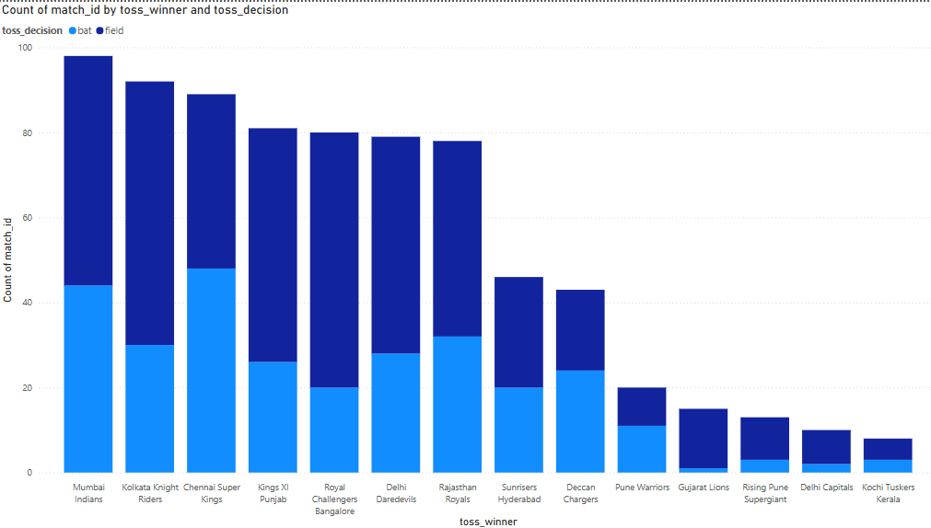
STACKED COLUMN CHART
From the above visual we can understand how many times a team has won the toss and which decision it has taken when they won the toss.

Slide 30
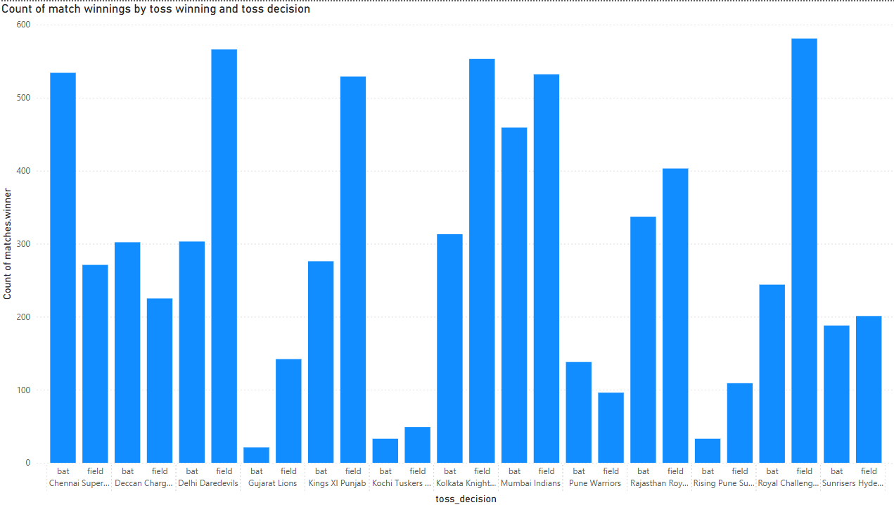
CLUSTERED COLUMN CHART
From the above visual, it shows which team has selected a toss decision and how many matches they have won by taking that decision.

Slide 31
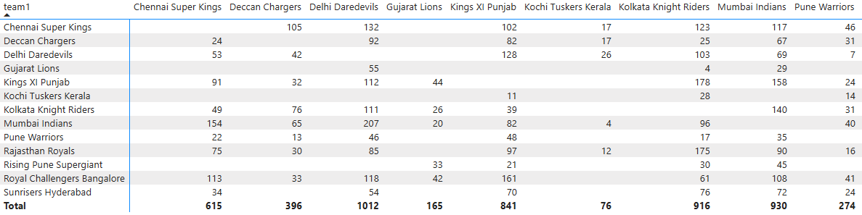
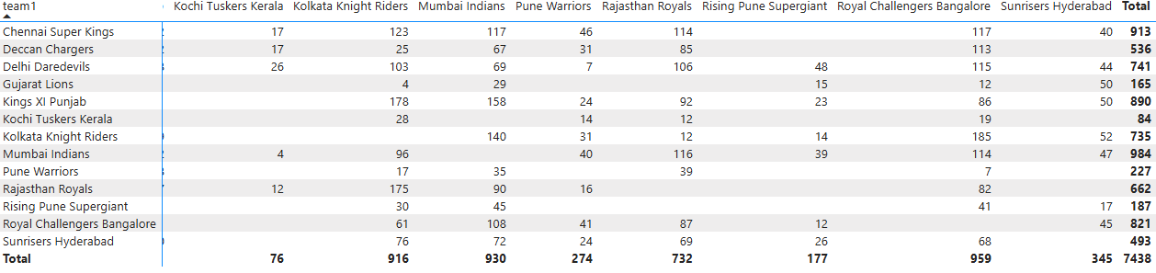
MATRIX
In the above visual it shows the team vs team rivalry and how many times a team has won against the another team

Slide 32
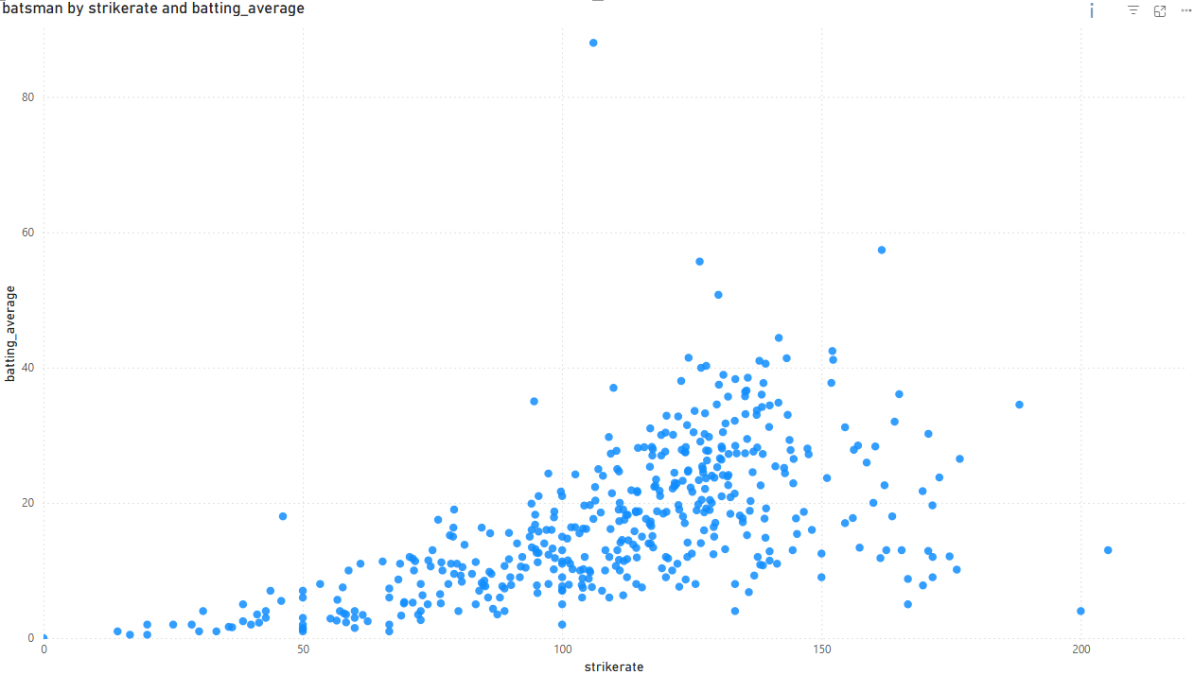
SCATTER CHART
The above visual shows the strike rate and average rate of a batsman. By pointing the mouse at the plot we can know the name of that batsman along with their strike rate and batting average.

Slide 33
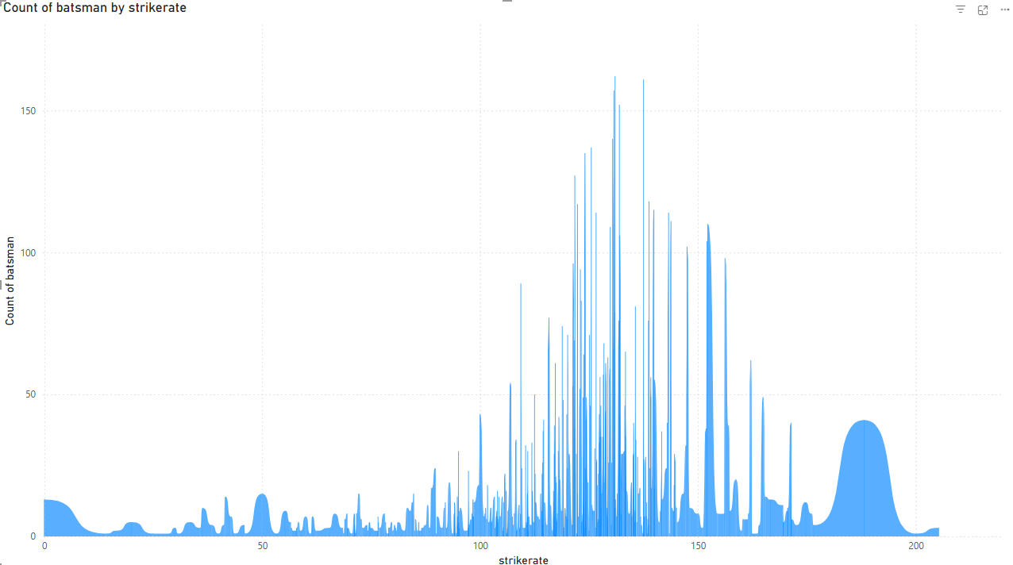
RIBBON CHART
The above visual shows how many players has played with a particular strike rate in the ipl from 2008-2019.

Slide 34
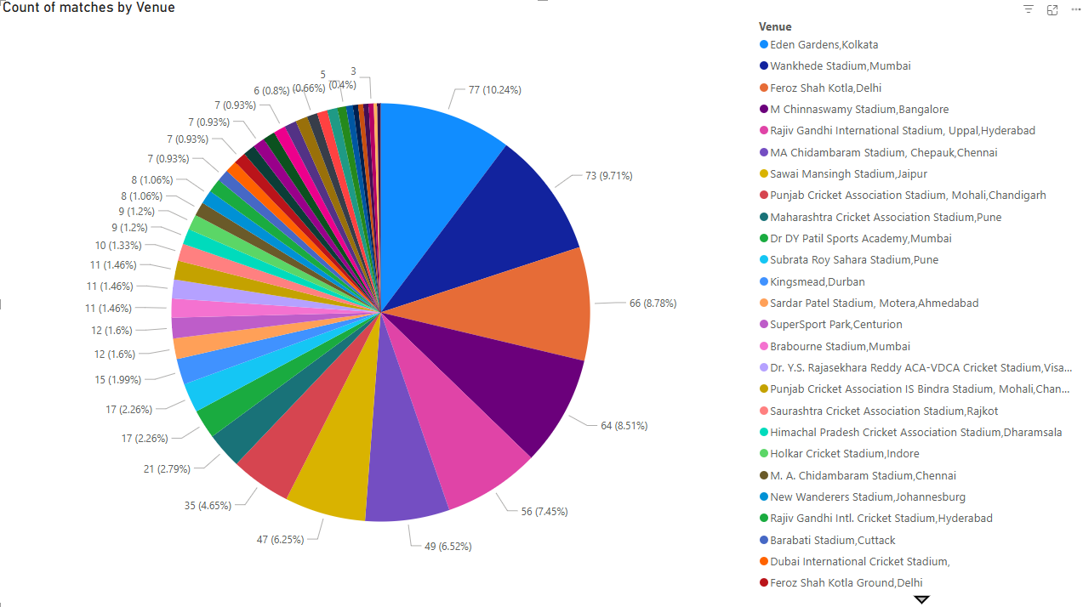
PIE CHART
The above visual states how many times a team has won in a particular stadium.

Slide 35
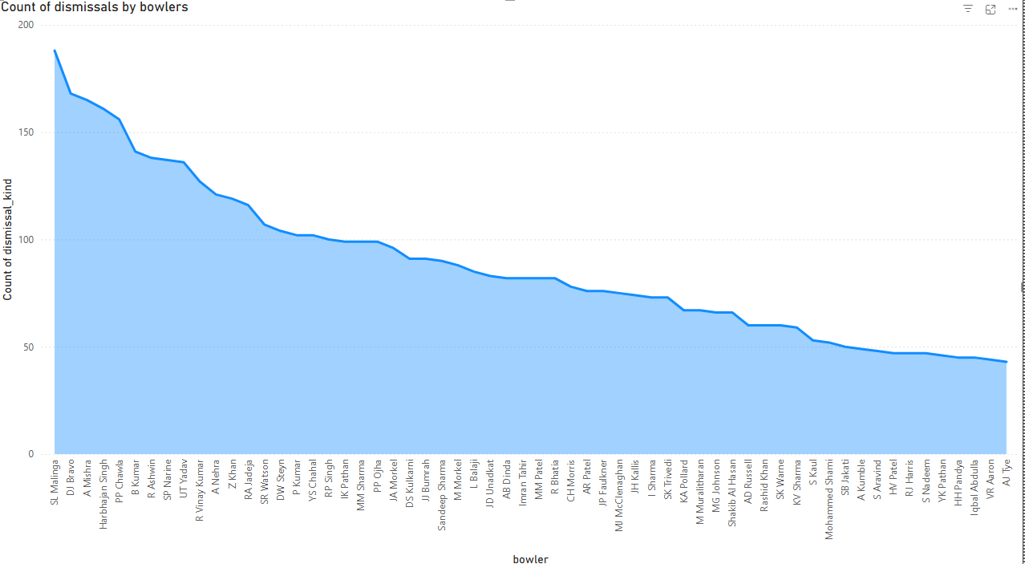
STACKED AREA CHART
The above Area Chart tells how many times a bowler has dismissed the batsmen while bowling. It shows that SL Malinga has taken the most number of wickets than compared to other bowlers.

Slide 36
FINAL INSIGHTS AND TAKEAWAYS
Mumbai Indians
Most match wins in IPL 2008–2019.
Umar Gul
Highest strike rate among all batsmen.
SL Malinga
Top wicket-taker in IPL history.
Eden Gardens, Kolkata
Most used venue during the analyzed seasons.
Toss Decision Analysis
Toss winners choosing to field won more than 55% of the time
Chasing Advantage
Teams chasing had better win percentages in certain seasons.

